Slide 1

Course Code: ICT 4255
Course Title: COMPUTER NETWORKING
PREPARED BY Mehrin Farzana ID:2101013 Session: 2021-2022 | SUPERVISED BY Md. Toukir Ahmed Lecturer Department of ICT, BDU
DATE OF SUBMISSION: 1 MARCH, 2023

Slide 2
Computer Networking
An overview of lectures from the first till present

Slide 3


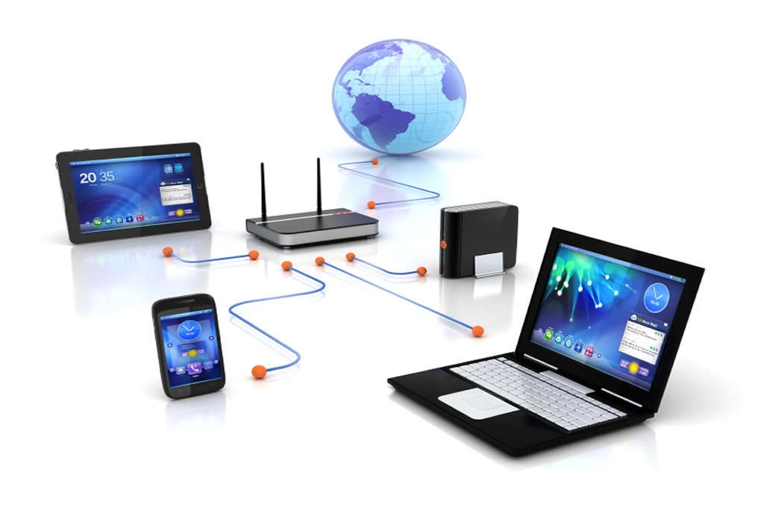
Topics
General terms
Data communication
Computer networking
Addressing
Fig 0.1: General terms
Source: https://www.bing.com/
Fig 0.2: Data communication
source: https://www.techerati.com/
Fig 0.3: Computer networking
source: https://blog.kara.com.ng
Fig 0.4: Addressing
Source: https://cybersecurityglossary.com/

Slide 4
General Terms
Education
Science
Research
Project
Engineering
Technology
Smart
Data
Data
Digital
Data
Fig 1.2: Information
Machine
Fig 1.3: Digital world is subset of smart world
COMPUTER
NLP
Fig 1.1: Flowchart of education to some technologies

Slide 5
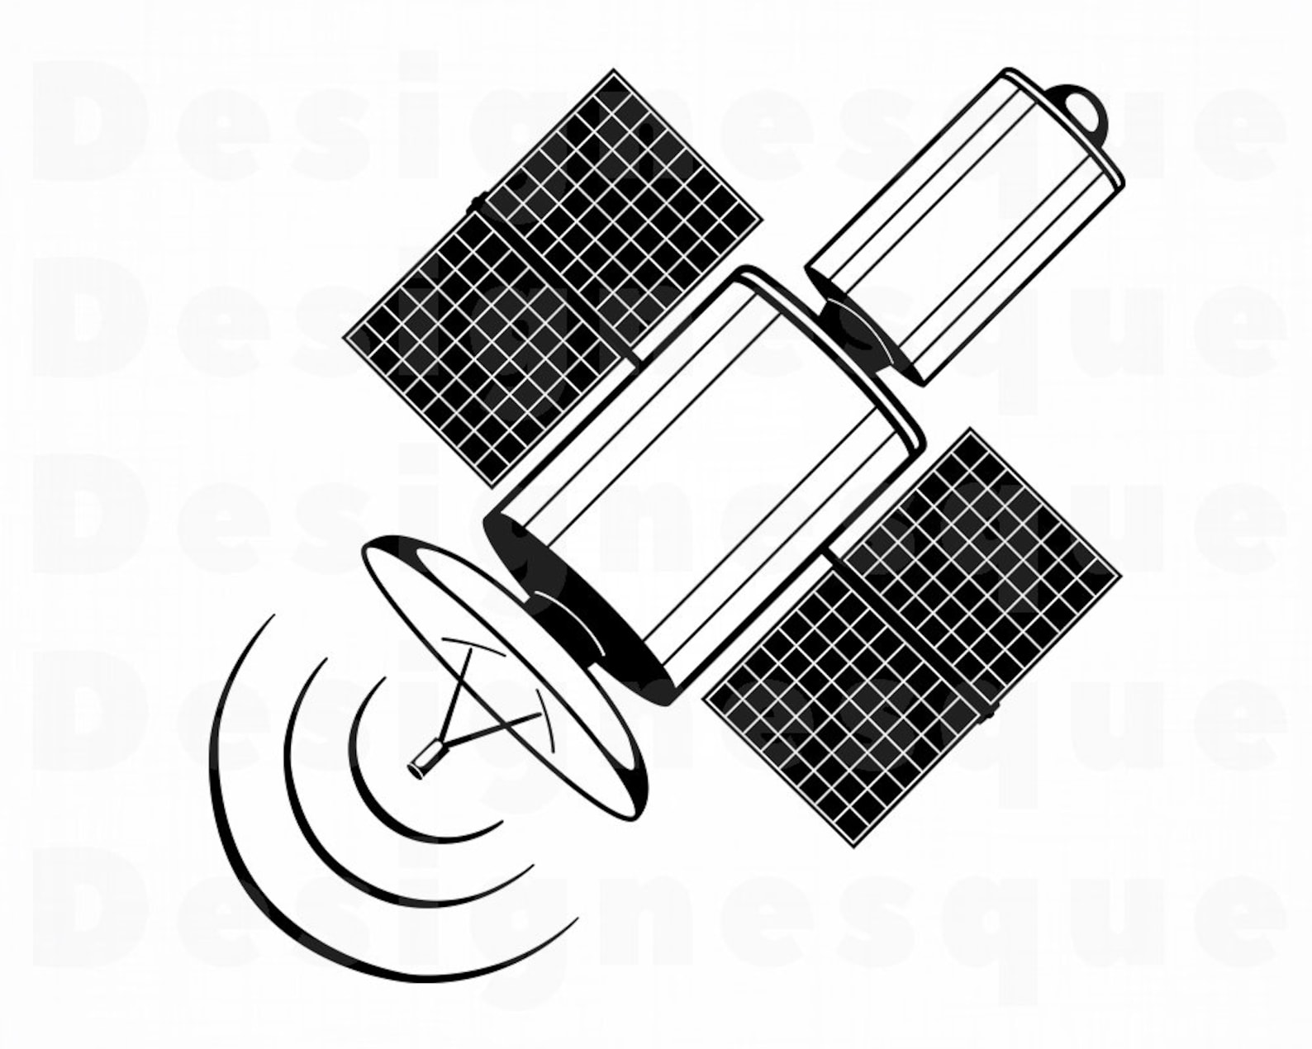
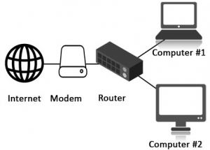
General terms
Internet Terms
Satellite
ISP = Internet Service Provider
NAP = Network Access Point
Fig 1.4: Computers connected to the Internet
source: etsy.com, educba.com

Slide 6


General terms
Internet Terms
Webpage
Webpage
Webpage
...
Website
DNS
Protocol :// Subdomain . Domain . Top level domain
URL/Web address
HTTP,
Telnet,
...
Search engine
WWW
...
Ciber crime<---->Cyber criminal
Fig 1.5: The internet
source: dreamstime.com, clipartspub.com/

Slide 7
Data Communication
Simplex
Reciever
Sender
Sender
Half-duplex
Reciever
Sender
Full-duplex
Reciever
Wi-Fi,
WiMAX,
...
Wire/Cable
Wireless
Fig 2.2: Data flow
Fig 2.1: Data communication components

Slide 8
Data communication
Data Communication Model
Link
Node
Fig 2.3: Data communication model
Network
Wireless data communication
Mobile communication
Fig 2.4: Wireless to mobile communication

Slide 9
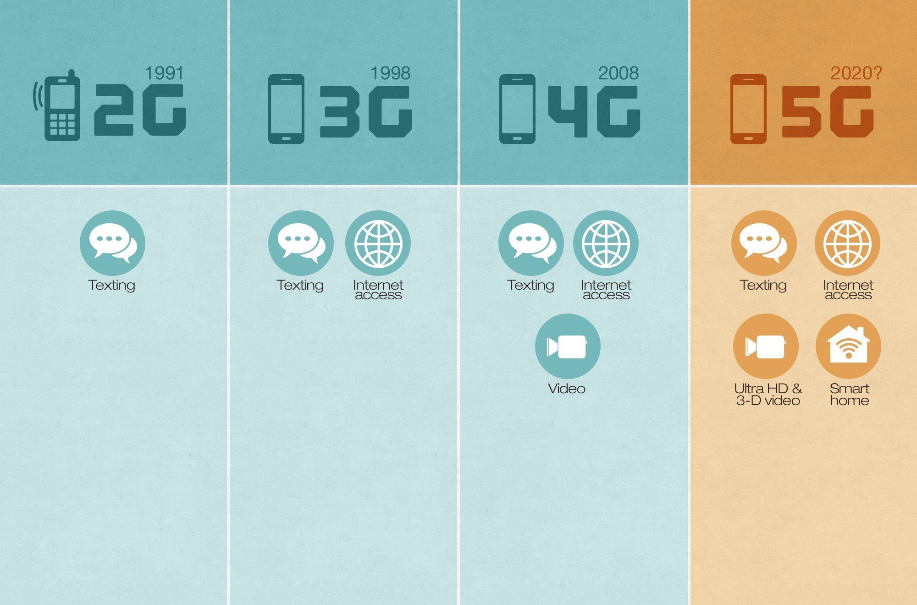
Data communication
Mobile Phone Generation
Fig 2.5: Mobile phone generations
source: https://www.pinterest.com

Slide 10
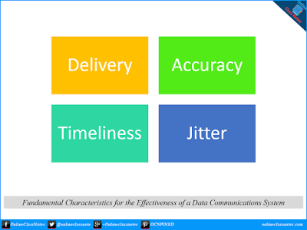
Data communication
Data Communication
Data communication tasks:
Transmission system
Interfacing
Signal generation
Synchronization
Exchange management
Error detection
Routing
Recovery
Security
Network management
Addressing
... ... ...
Fig 2.6: Effectiveness of data communication

Slide 11
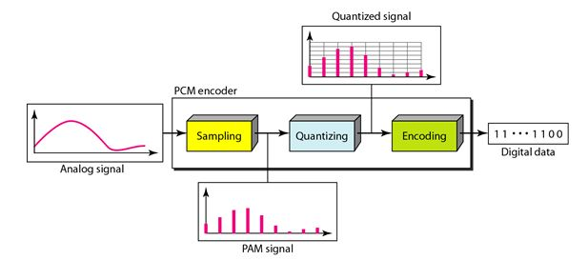
Data communication
Siganl Modulation
Fig 2.7: Signal modulation
Source: myreadingroom.co.in/

Slide 12
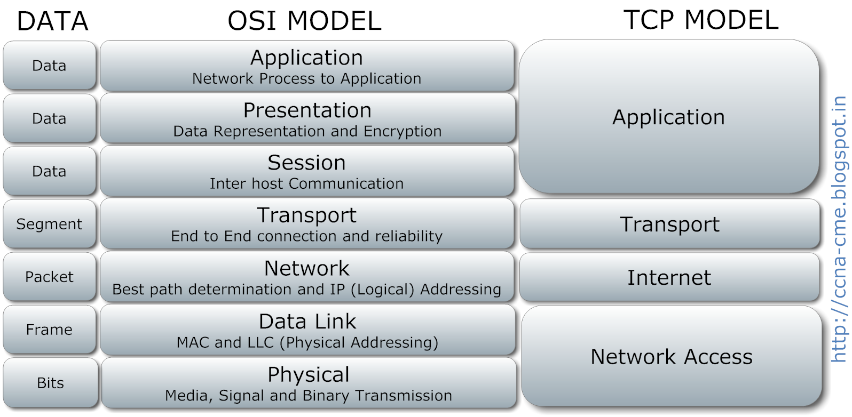
Data communication
Data Communication Models
Each layer in a model is connected to layers before and after it with an inteface.
Fig 2.8: OSI and TCP models
Source: blogspot.com

Slide 13
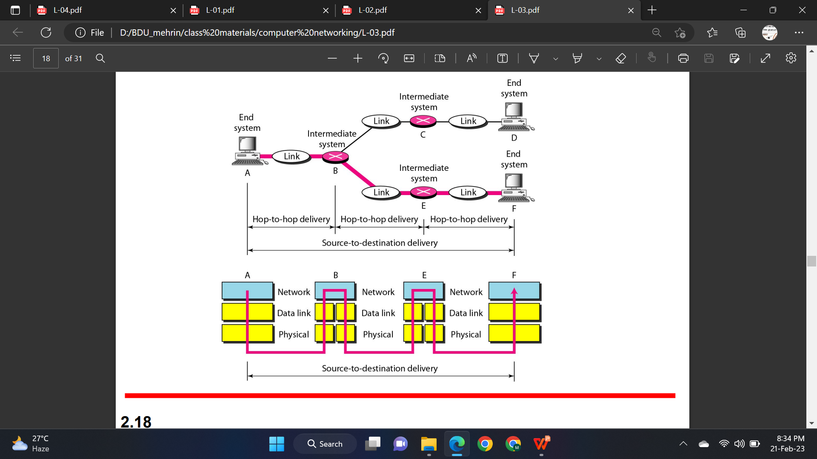
Data communication
Data Delivery System
Fig 2.9: Hop-to-hop and source-to-destination delivery in data communication model
Source: The McGraw-Hill Companies

Slide 14
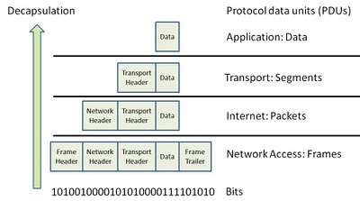
Data communication
Data across TCP Layers
Fig 2.10: Segment, packet, and frame
Source: qastack.it

Slide 15
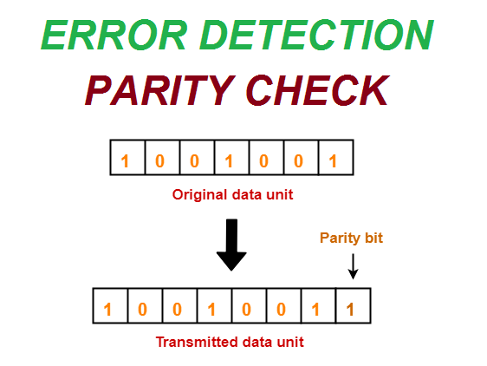
Data communication
Data Transmission as Bits
Fig 2.11: Data transmission as bits having a parity bit
Source: medium.com

Slide 16
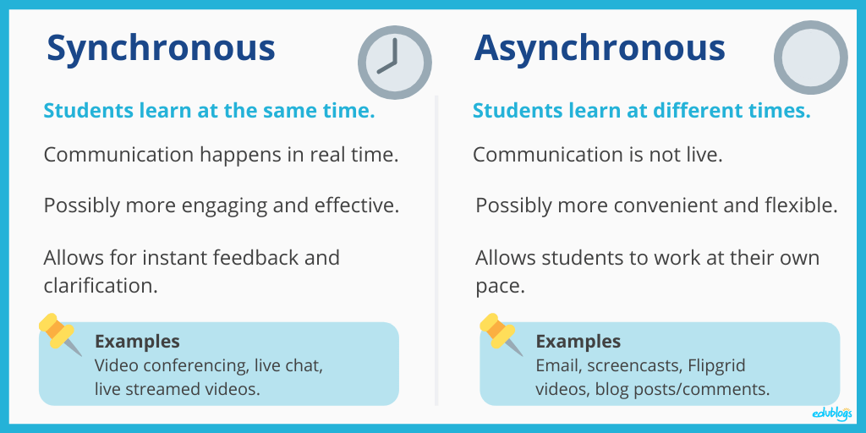
Data communication
Data Transmission Method
devices
Fig 2.12: Data transmission method
Source: theedublogger.com

Slide 17
Computer Networking
Point-to-point
Network criteria
Physical structure
Point-to-multipoint
Performance
Bus
Type of connection
Reliability
Physical topology
Star
Ring
Security
Logical topology
Tree
Categories
Mesh
Network topology
Hybrid
PAN
LAN
MAN
WAN
Fig 3.1: Computer networking

Slide 18
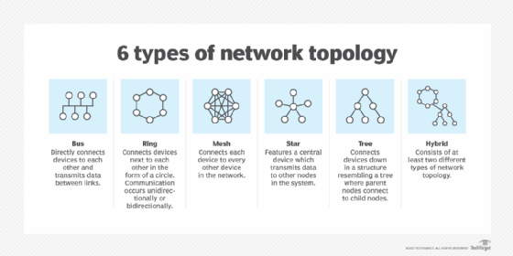
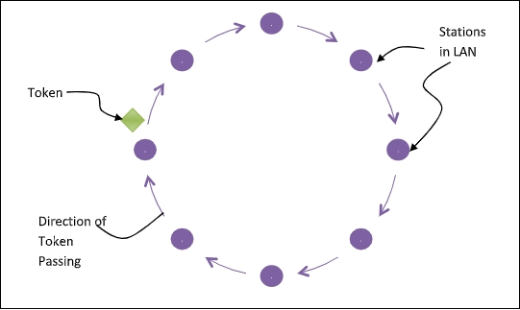
Computer Networking
Network Topology
+ 1 special
Bus
Ring
Mesh
Star
Tree
Hybrid
Node
Token ring
Token
Direction of token movement
Fig 3.2: Network topology
source: technicalcaps.com

Slide 19
Computer Networking
Network Connectivity Device
Actuve hub
Modem
Passive hub
Intelligent hub
Fig 3.3: Network connectivity devices
Source: eu.dlink.com, slideshare.net

Slide 20
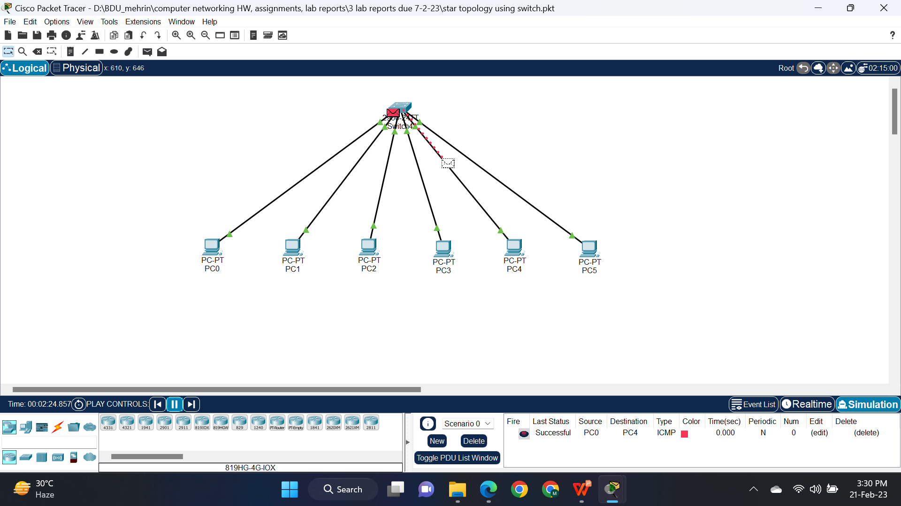
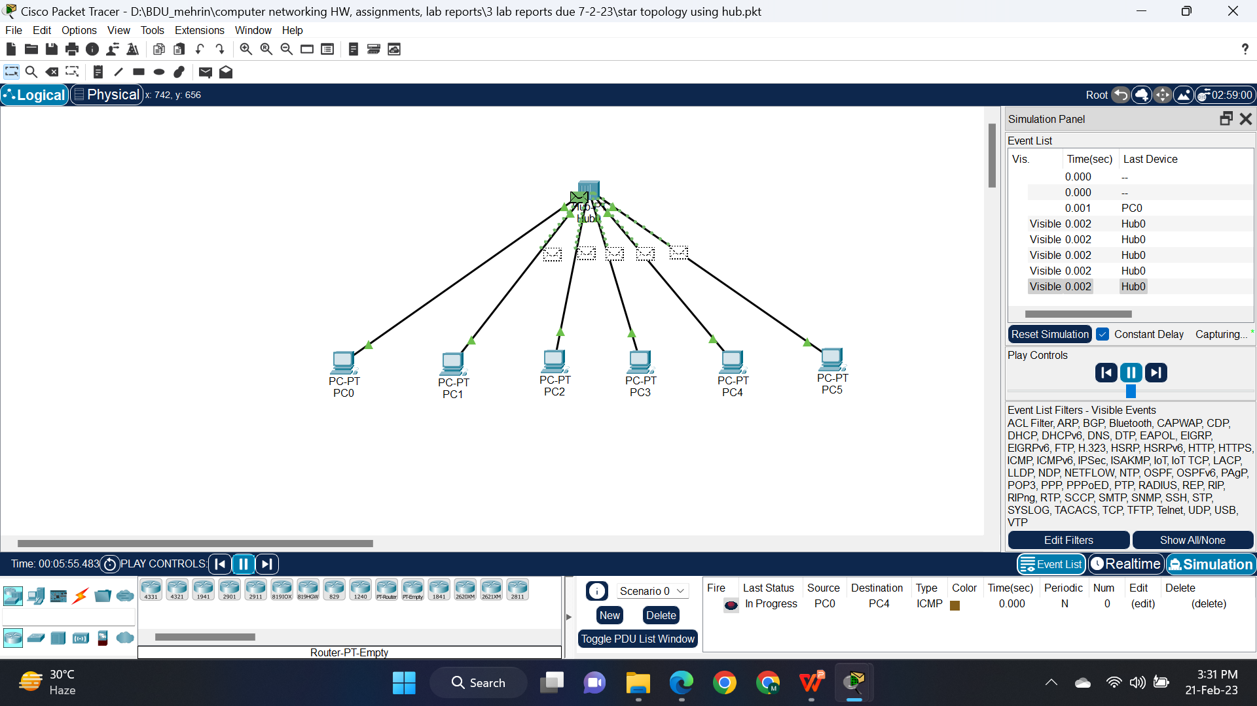
Computer Networking
Switch vs Hub
Fig 3.4: Switch sending packet to only the destination computer whilst hub sending packet to all the connected computers except the host.

Slide 21
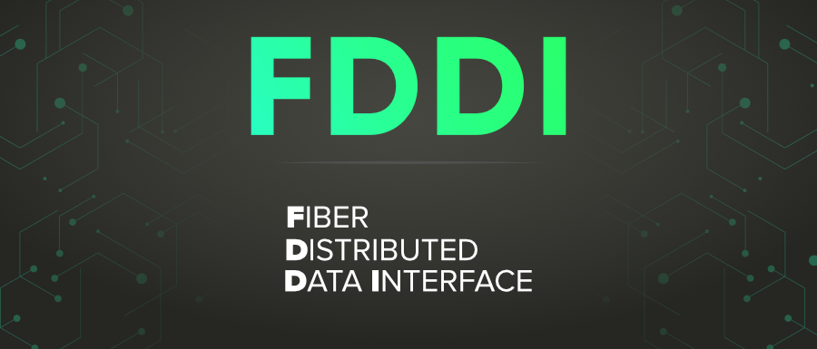
Computer Networking
FDDI
FDDI components
2 token rings
Primary
Secondary
Fiber optic cable
Concentrator
Adapter
Fig 3.5: FDDI
Source: geksforgeeks.org

Slide 22
Computer Networking
Fiber Optical Network
PON
EPON | GPON
More efficient & secure & economical | More efficient & economical

Slide 23
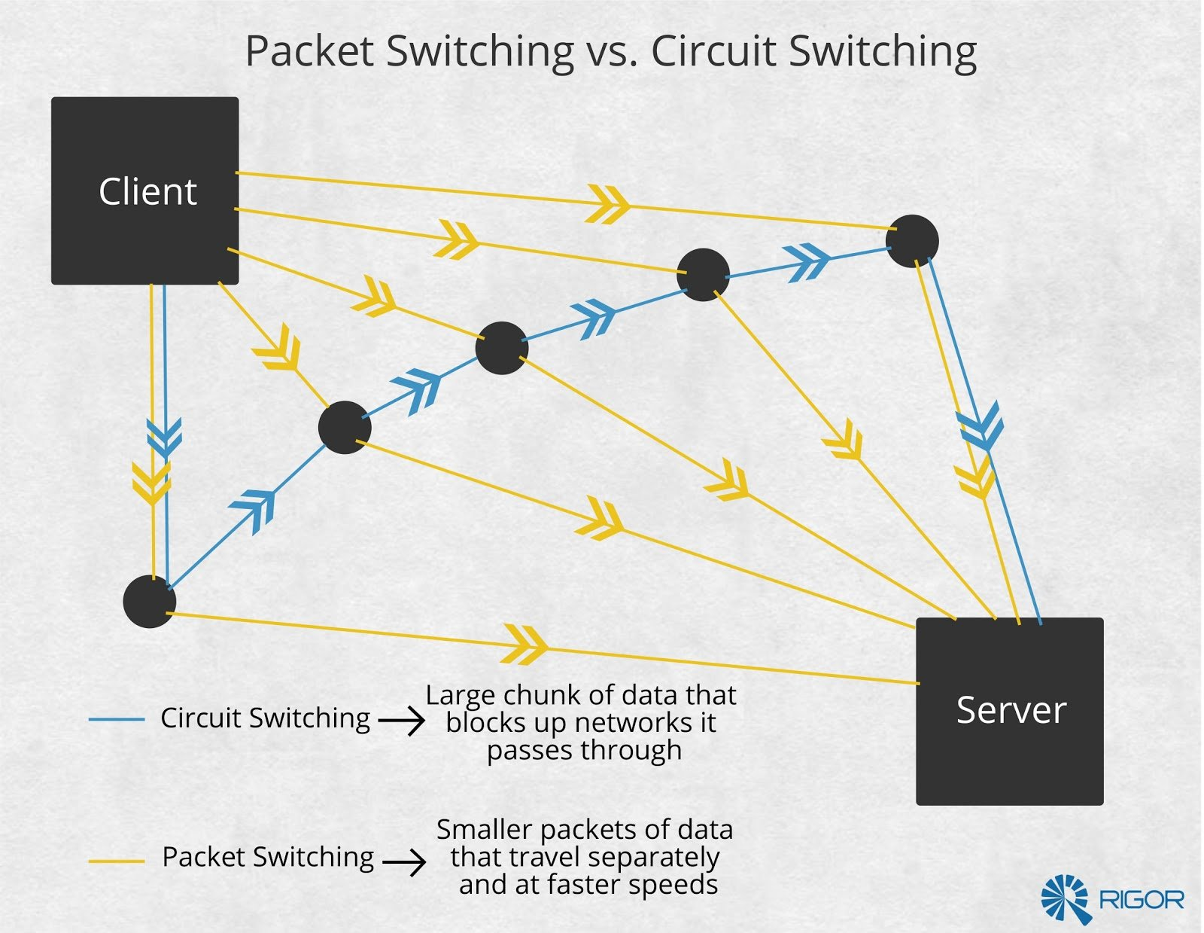
Computer Networking
Switching
Fig 3.6: Circuit switching vs Packet switching
Source: rigor.com

Slide 24
Network Protocol
Tasks:
Key elements of a protocol:
Encapsulation & Decapsulation
Syntax
Semantic
Timing
Fragmentation & reassembly
Transmissin security and rerliability
Conection establishment, synchronization & addressing
Some protocols:
. . .
IP
DNS
HTTP
. . .

Slide 25
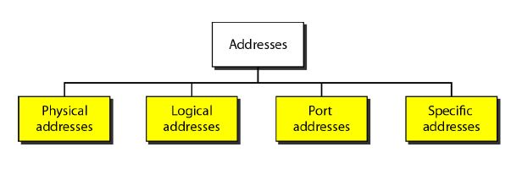
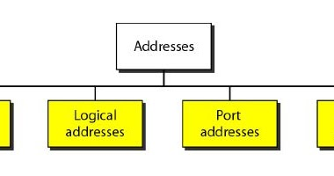
Addressing
aka MAC address
aka IP address
Fig 4.1: Addressing types
Source: blogspot.com

Slide 26
Addressing
PDU and Layer Addressing
Source Port | Destination Port | . . . | Data
Segment
Source IP | Destination IP | Protocol | . . . | Segment
Packet
Destination MAC | Source MAC | Packet | Trailer
Frame
Fig 4.2: PDU and layer addressing

Slide 27
Thank You

